Slide 1
Section IV: Anisotropic Friction
The Matchstick Model

Slide 2
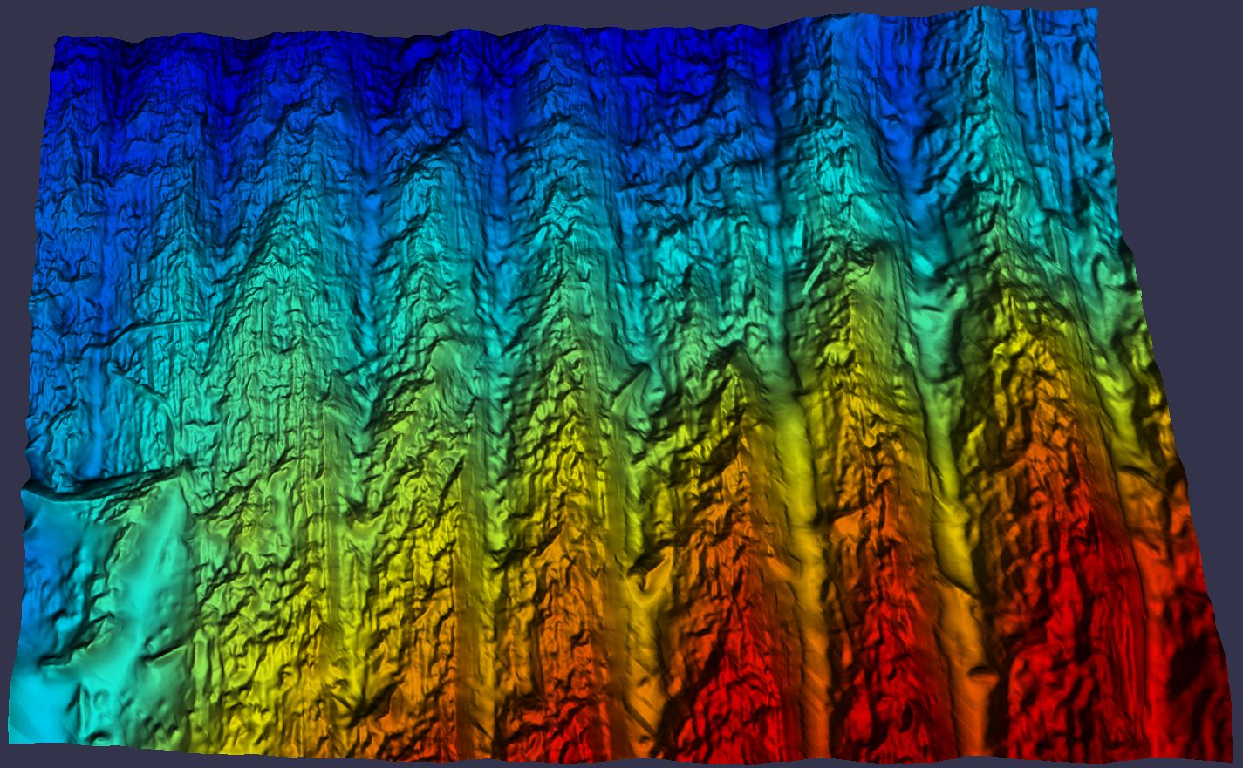
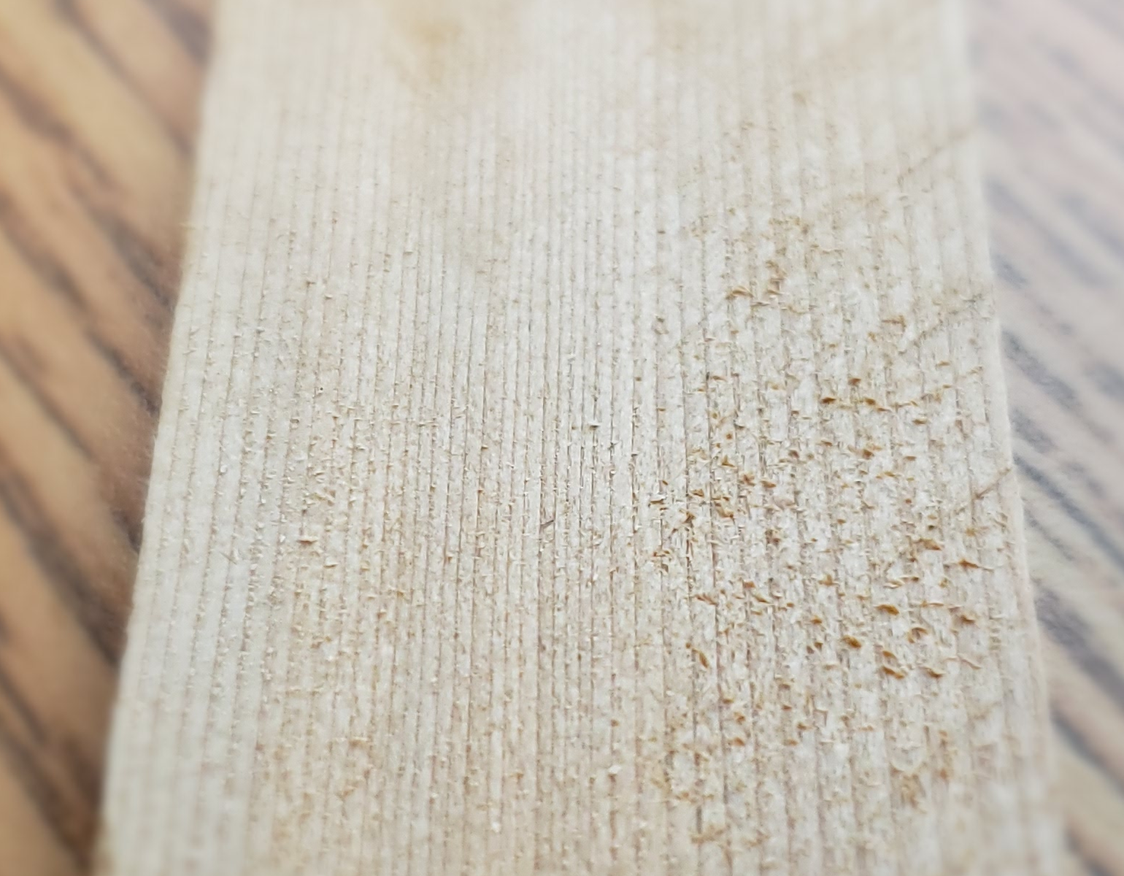
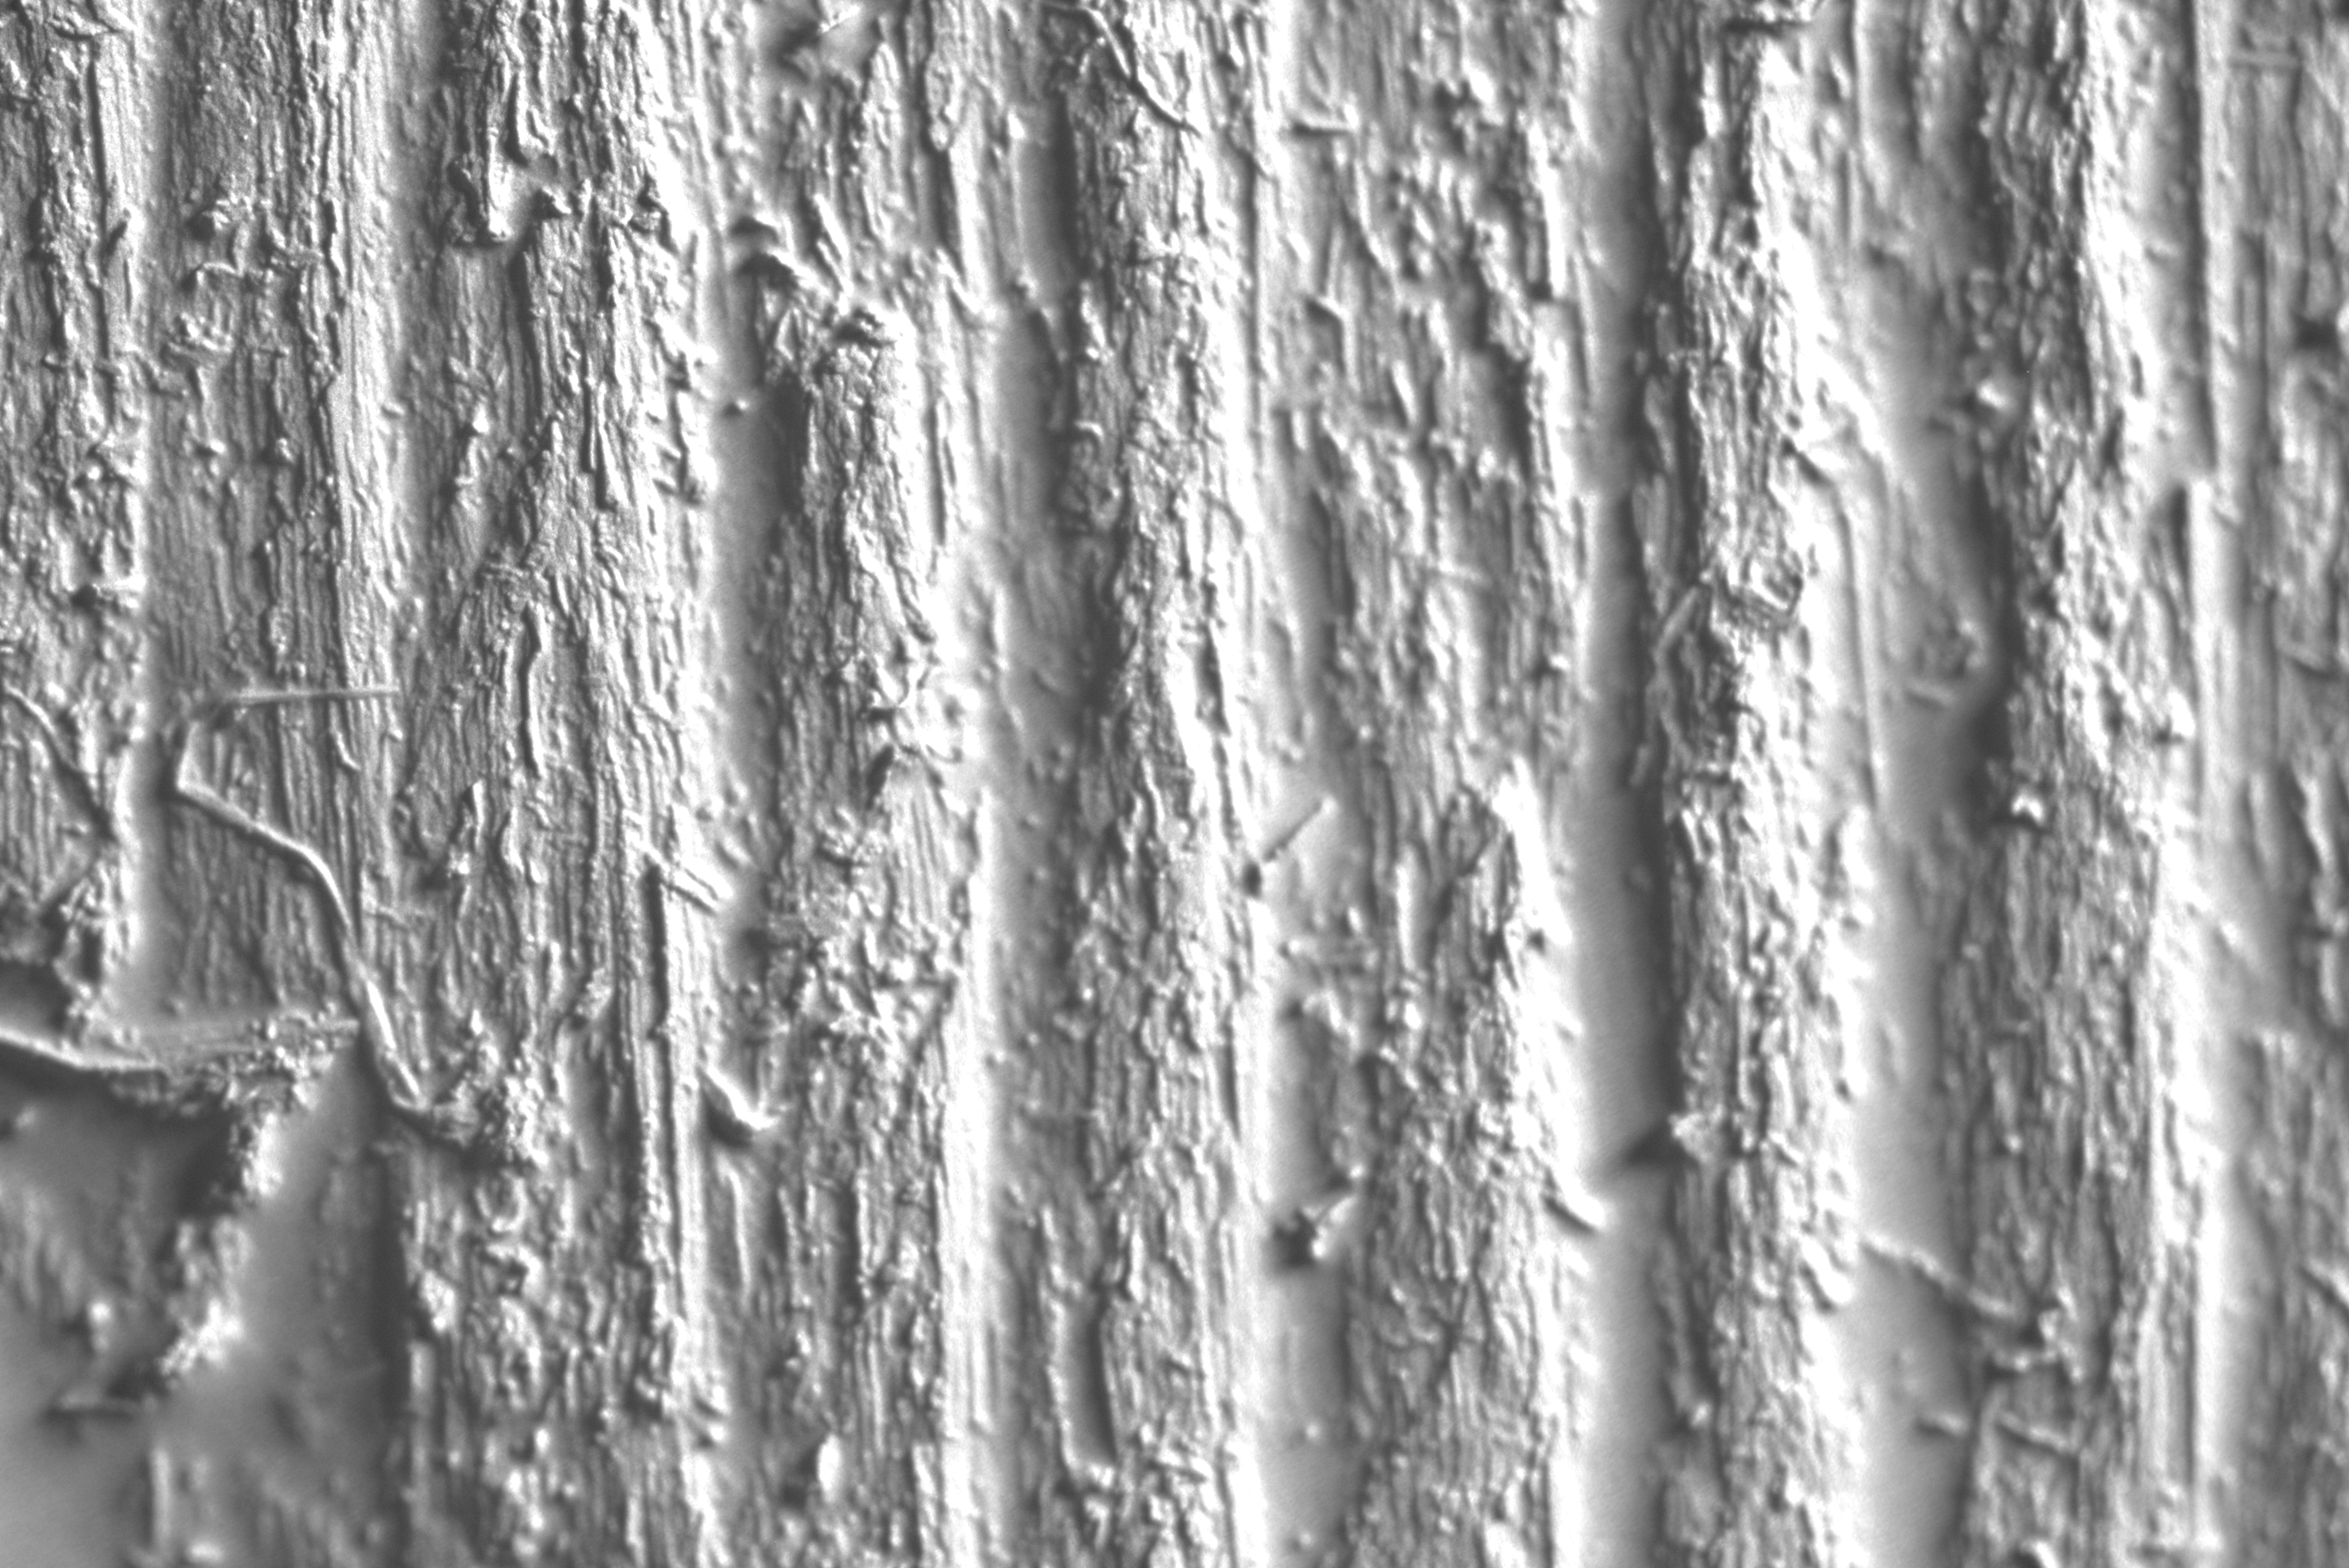
Anisotropic Friction
Notes:
I will start by presenting the core observation behind the matchstick model.
CLICK
The model originates form the observation that many everyday materials have highly anisotropic surface geometry as shown in this wood example.
CLICK
Here a wood sample was scanned at micron scale.
CLICK
The jet colored height map on the right reveals a structure of ridges and groves that can be described by a single direction vector,
This fiber direction describes the smoothest direction of the material geometry.
Before I explain how I can use these fiber directions I will just quickly recall how friction models usually are described.

Slide 3
Anisotropic Friction
Notes:
I will start by explaining how we represent an isotropic friction model.
To describe it I need a contact frame defined by the unit contact normal vector n
The contact plane is spanned by the tangent vector t and the binormal vector b.

Slide 4
Anisotropic Friction
Notes:
The isotropic Coulomb friction model is defined by this circular cone.
I call this the isotropic friction cone, and it describes all feasible contact forces between a pair of materials.
The slope of the cone is given by a single coefficient of friction called mu.
The cone is radial symmetric so there is no need to describe its orientation.

Slide 5
Anisotropic Friction
Notes:
For a given fixed value of the normal force denoted by lambda n I can think of the cone as a 2D circle in the contact plane.

Slide 6
Anisotropic Friction
Notes:
I can draw this in 2D like this.
The 2D circle describes the boundary of the set of all feasible planar friction forces that I represent by the component's lambda t and lambda b.
I will often only use these 2D cone illustrations to illustrate the friction model as I without loss of generality will assume the normal force is known.

Slide 7
Anisotropic Friction
Notes:
I will now explain an anisotropic friction model.
Here I use a local contact frame defined in the same way as for the isotropic case.

Slide 8
Anisotropic Friction
Notes:
However, the cone shape is different.
It has an elliptical shape and I need two parameters mu t and mu b to describe this shape.

Slide 9
Anisotropic Friction
Notes:
As I did for the isotropic case
I can look at the shape of the cone for a fixed known value of the normal force.
This is just an ellipse in the contact plane

Slide 10
Anisotropic Friction
Notes:
As before I can now use a 2D illustration of the friction cone.
Observe that I use the convention of having the tangent vector pointing in the direction of minimum friction.
When using an anisotropic model in a simulator one must figure out how to find the tangent and binormal directions in the world space.
I refer to this sub-problem as finding the cone orientation.

Slide 11
Anisotropic Friction
Notes:
I will now return to talk about how the fiber directions are related to the friction cone.
Imagine I take one block of material with a very clear fiber direction as shown here.

Slide 12
Anisotropic Friction
Notes:
I will now put another block on top such that fiber directions of the two blocks are parallel
Observe the interlocking effect of the two contact surfaces

Slide 13
Anisotropic Friction
Notes:
Imagine that I move the top block while keeping the bottom block fixed
Due to the surface geometry I assume that there will be low resistance when moving along the fiber directions but when moving orthogonal I assume to feel a much higher resistance.
Hence, I have a case of extreme anisotropic friction

Slide 14
Anisotropic Friction
Notes:
Imagine I take another block

Slide 15
Anisotropic Friction
Notes:
This time I put a block on top such that fiber directions are at some skewed angle

Slide 16
Anisotropic Friction
Notes:
Imagine I move the top block while holding the bottom one fixed.
Here I assume to feel less resistance when moving in the average direction of the fibers, but the orthogonal direction would give more resistance.
I have a case of anisotropic friction but not as extreme as when fibers are parallel

Slide 17
Anisotropic Friction
Notes:
I will consider one more case
I take another block of material

Slide 18
Anisotropic Friction
Notes:
This time I place a block on top with orthogonal fiber direction

Slide 19
Anisotropic Friction
Notes:
When I move the top block in different directions, we will assume that are no apparent difference in resistance as there are no preferred geometries.
Hence, I have a case of isotropic friction

Slide 20
Anisotropic Friction
Interpolate
Notes:
The core idea is to make the friction cone depend on the fiber directions to interpolate between the friction cases.
The challenges I am facing are
How to change the cone shape depending on fiber directions
How to determine the cone orientation
How to deal with a dynamic state dependent friction cone when solving for contact forces.
Later I will talk about how to deal with each of these challenges.

Slide 21
Anisotropic Friction
<<<<<<<<
<<<<<<<<
Notes:
I will now outline the details of the matchstick model.
I have two bodies A and B

Slide 22
Anisotropic Friction
<<<<<<<<
<<<<<<<<
Notes:
A and B come into contact at a single point of contact

Slide 23
Anisotropic Friction
<<<<<<<<
<<<<<<<<
Notes:
The common contact normal defines the local contact plane that has the unit normal vector n

Slide 24
Anisotropic Friction
<<<<<<<<
<<<<<<<<
Notes:
The tangent spaces at the points of contact on A and B define the local space where the fiber directions S_A and S_B lives.
One can use texture maps to store fiber directions, or procedurally generate the fibers on the fly when they are needed.

Slide 25
Anisotropic Friction
<<<<<<<<
<<<<<<<<
Notes:
The average fiber direction is used to define the tangent vector of the contact plane and binormal vector is computed from the tangent and normal vectors.

Slide 26
Anisotropic Friction
<<<<<<<<
<<<<<<<<
Notes:
The world space vectors that span the contact frame defines a rotation matrix that transform world space into the local contact space.

Slide 27
Anisotropic Friction
Notes:
Using all these transformations I only need to look at the local contact space.

Slide 28
Anisotropic Friction
Notes:
In this space the axis of least resistance is pointing in the x-axis direction and the contact normal is pointing towards me.

Slide 29
Anisotropic Friction
Notes:
I may now illustrate the boundary of the isotropic coulomb cone for some fixed value of the normal force magnitude.

Slide 30
Anisotropic Friction
Notes:
In the same way I can illustrate the extreme anisotropic friction cone.
Remember I assume fiber directions point in direction of least resistance, so the cone will always be thinner in the tangent direction than in the binormal direction.

Slide 31
Anisotropic Friction
Notes:
I need to interpolate between the extreme anisotropic cone and the isotropic cone.
To do this I use the minimum angle between the fiber directions.
I rescale the angle value to be between 0 and 1 and then I do a linear interpolation of the coefficients of friction.

Slide 32
Anisotropic Friction
Notes:
This is essentially spherical linear interpolation.
One could choose other interpolation schemes.
I just picked this scheme in my presentation here because it is simple.

Slide 33
Anisotropic Friction
Notes:
With the new interpolated friction parameters I can now write the definition of the matchstick friction cone.
I will now illustrate the matchstick friction cone.

Slide 34
Anisotropic Friction
Notes:
It will be some place between the isotropic and extreme anisotropic cones.

Slide 35
Anisotropic Friction
Notes:
Here I have highlighted the matchstick cone with red color to make it easier to see.

Slide 36
Anisotropic Friction
Notes:
I have now presented the Matchstick cone model.
Next, I will talk about how to use it to solve for the friction forces.

Slide 37
Anisotropic Friction
Notes:
One approach is to use a proximal operator scheme.
This scheme recast the physics into a fixed-point problem

Slide 38
Anisotropic Friction
Notes:
This fixed-point problem can be interpreted as a closest point projection problem. Here I will quickly outline how this works.
First, I find the relative sliding velocity v from the kinematic relation with the contact Jacobian.

Slide 39
Anisotropic Friction
Notes:
Then the fixed-point solution can be seen to be the point lambda that is the closest point on the cone boundary to any point on the half line starting at lambda and pointing in the negative v direction.
The thing to underline here is that one must generate a cone every time one solves the proximal operator problem, that is because fiber directions are changing when objects move, so the cones are changing their shape and orientation too over time.

Slide 40
Anisotropic Friction
Notes:
I will now look at a different approach for solving for the forces.

Slide 41
Anisotropic Friction
Notes:
A different way to write up the cone is to use an implicit function representation like this

Slide 42
Anisotropic Friction
Notes:
This implicit eta function is negative inside the cone, positive outside and zero on the boundary of the cone.

Slide 43
Anisotropic Friction
Notes:
I will assume I have some nonzero sliding velocity like before when I explained the proximal operator approach.
I know how the solution looks like from the proximal operator setting.
This time I will look at the gradient of the eta function at the lambda solution.

Slide 44
Anisotropic Friction
Notes:
I can observe that the gradient is parallel to the half line going in the direction of the negative v.
I now defined some non-negative number beta and the auxiliary vector w.
The vector w will be used as a measure of whether the gradient of eta points in the same direction as the negative v direction.

Slide 45
Anisotropic Friction
Notes:
I can observe that if the velocity is non-zero then a positive beta must exist such that w is zero.
In this case I am on the boundary of the cone which means that the eta function is zero.
If the eta function is negative, then I know I am inside the cone.
This means the velocity v must be zero. In this case I want beta to be zero too, but this means w can be non-zero.

Slide 46
Anisotropic Friction
Notes:
This looks awful complicated but if I make use of a nonlinear complementarity function that I here just call psi to keep it general then I can write up the complementarity conditions in a quite simple and compact form.

Slide 47
Anisotropic Friction
Notes:
These equations are the foundation for any nonlinear complementarity-based solver.

